Slide 1
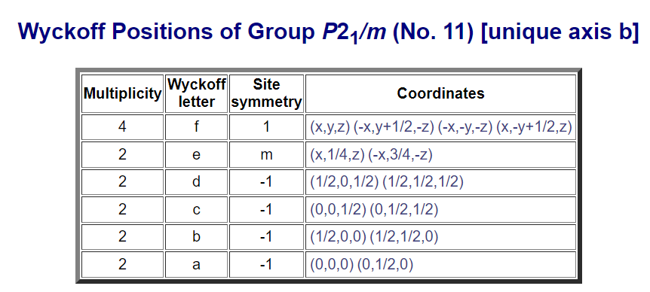
Brief Summary on Wyckoff Positions
Wyckoff positions tell us where the atoms in a crystal can be found.
Which symmetry is present at the site
How many atoms are generated by symmetry if we place a single atom at that position.
Position of atoms, where they can reside according to their Wyckoff Symbol.
(apply these co-oridinates to the x,y,z position you will get the positions of other the atoms. They are the fractional coordinates.)
The letter is simply a label and has no physical meaning.
They are assigned alphabetically from the bottom up.
When an atom resides at an arbitrary position, that Wyckoff position is called General Position.
When an atom resides on symmetry element, that Wyckoff position is called Special Position.
General position has higher multiplicity than Special position.
NOTE : According to my understanding, we should have the initial (x,y,z) position and space group type, to apply these operations.
Wyckoff positions for any space group can be found on this website -
https://www.cryst.ehu.es/cgi-bin/cryst/programs/nph-wp-list?gnum=11

Slide 2
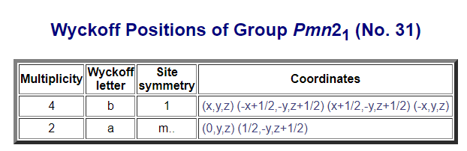
Atom position using WP for WTe2
Points we should know -
WTe2 – Space group – Pmn2₁ (No. 31)
Lattice constant : a = 3.477
b = 6.249
c = 14.017
Wyckoff Position (WP) – 2a
Note : Every atom has 2a position
Initial X,Y, Z
Note : according to my understanding we should know initial X, Y, Z. (I am not confirmed where to get the initial or how to provide the initial X, Y, Z.
Steps to calculate the positions –
See the WP table and use the coordinates belonging to the given WP letter (in this case 2a). Multiplicity is 2. So every atom will produce 2 positions.
For W(1) : (0, Y, Z) → (0, 0.60, 0.5) #(NOTE: I am using initial values from Sensei file)
(1/2, -Y, Z+1/2) → (0.5, 1-0.60, 0.5+0.5)
NOTE: Sometimes the addition make the no. greater than 1 or less than 0. So, we need to substrate or add 1 respectively to bring the atom back into the unit cell.
Similarly, other atoms position we can obtained from the table as –
For W(2) : W2 = (0, 0.03, 0.015); (0.5, 1-0.03, 0.015+0.5);
Te1 = (0, 0.85, 0.655); (0.5, 1-0.85, 0.655+0.5);
Te2 = (0, 0.646, 0.11); (0.5, 1-0.646, 0.11+0.5);
Te3 = (0, 0.298, 0.859 ); (0.5, 1-0.298, 0.859+0.5 );
Te4 =(0, 0.207, 0.403 ); (0.5, 1-0.207, 0.403+0.5 );
3. To generate the lattice, using → R : n₁a + n₂b + n₃c , where n_{i} are integers.
NOTE : This is how I created the getbasis2_w.m file for my program.

